Slide 1




NEXT GEN EMPLOYABILITY PROGRAM
Creating a future-ready workforce
Team Members
College Name
Student Name :ct.swetha
Student ID :912421104049
Shanmuganathan engineering college

Slide 2

CAPSTONE PROJECT SHOWCASE
Project Title
Voting Application using Django Framework-swetha-(4049,SEC)
Abstract | Problem Statement | Project Overview | Proposed Solution | Technology Used | Modelling & Results | Conclusion

Slide 3
Abstract : Django Online Voting System
Casting a ballot is a fundamental concept in our democratic structure. We consider voting to be one of the most essential rights in our society. The proposed e-voting system facilitates users in making their choices without physically visiting polling stations. This system leverages the power of the internet to enable eligible voters to cast their votes remotely.
Source :

Slide 4
Problem Statement
Technologies used in the project: Django framework and SQLite database which comes by default with Django.
Implementation of the Project
Creating Project
Create Models
Create an Admin User
Create Views
Create Templates
Create Landing Page
Create routing inside the main urls.py file of the application
Testing of the Application
User Frontend
Source :

Slide 5
Proposed Solution
.
Project Setup:
Start a new Django project: django-admin startproject voting_app.
Create a new Django app for the voting functionality: python manage.py startapp vote.
Models:
Define models for your voting system. For example, you might have a Poll model to represent each poll and a Choice model to represent the choices for each poll.
Source :

Slide 6
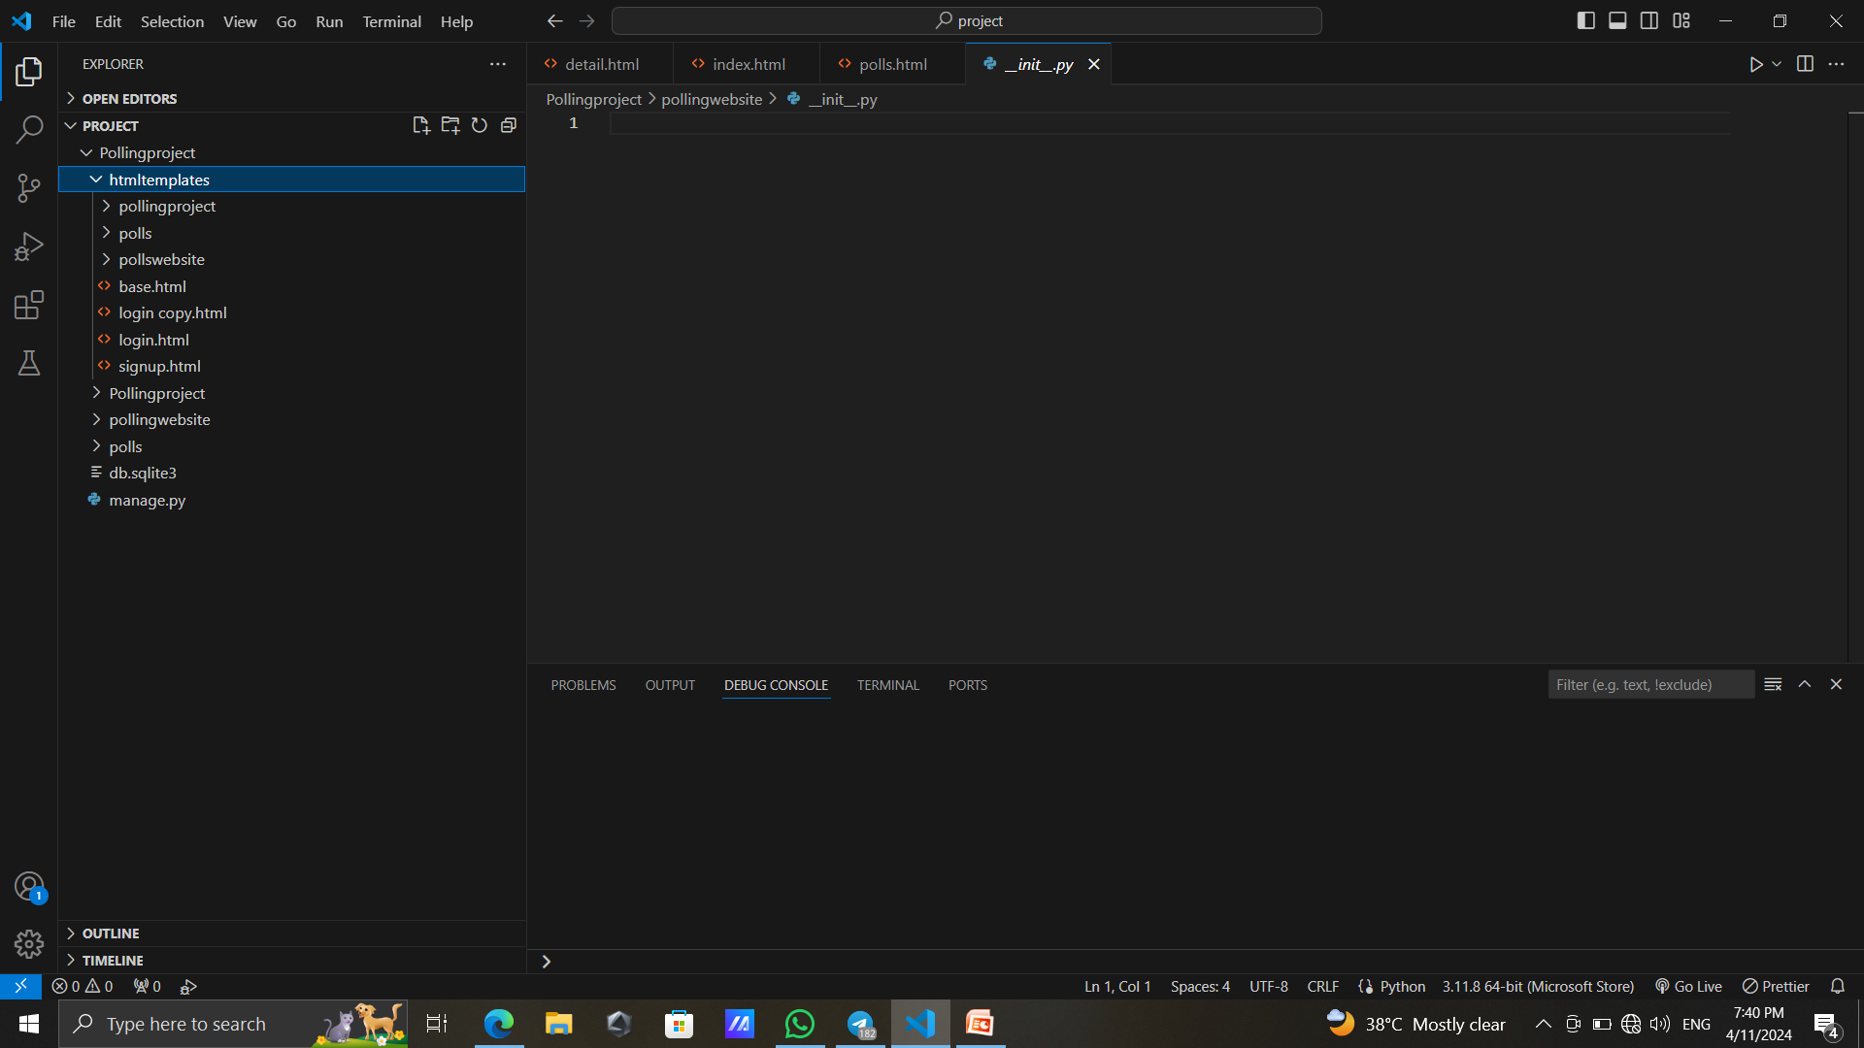

Slide 7
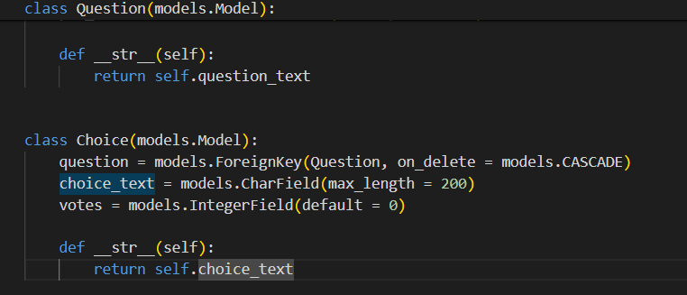
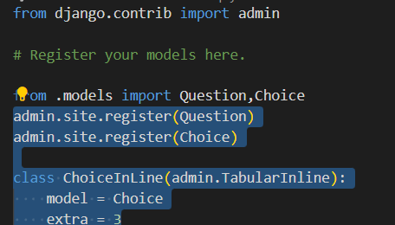
Models.py
Admin.py
Source :

Slide 8
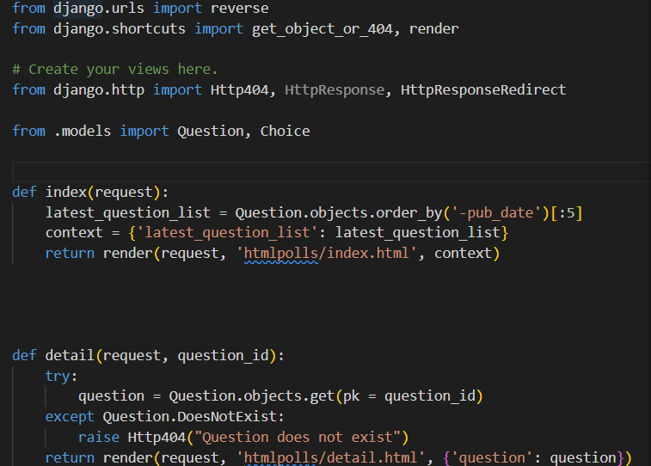
Views.py
Create view to handle displaying polls and submitting
votes
Source :

Slide 9


Technology Used
Front-end
Back-end
Source :

Slide 10
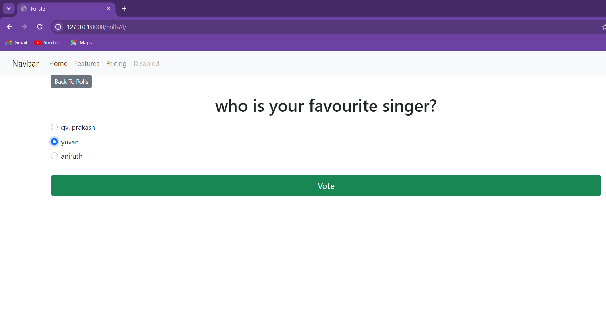
Modelling & Results
Source :

Slide 11
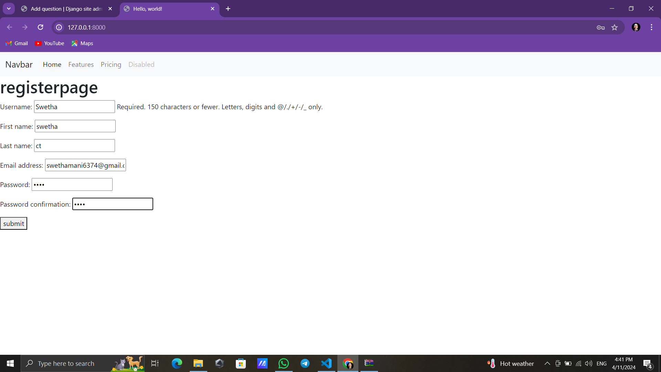
Register page

Slide 12
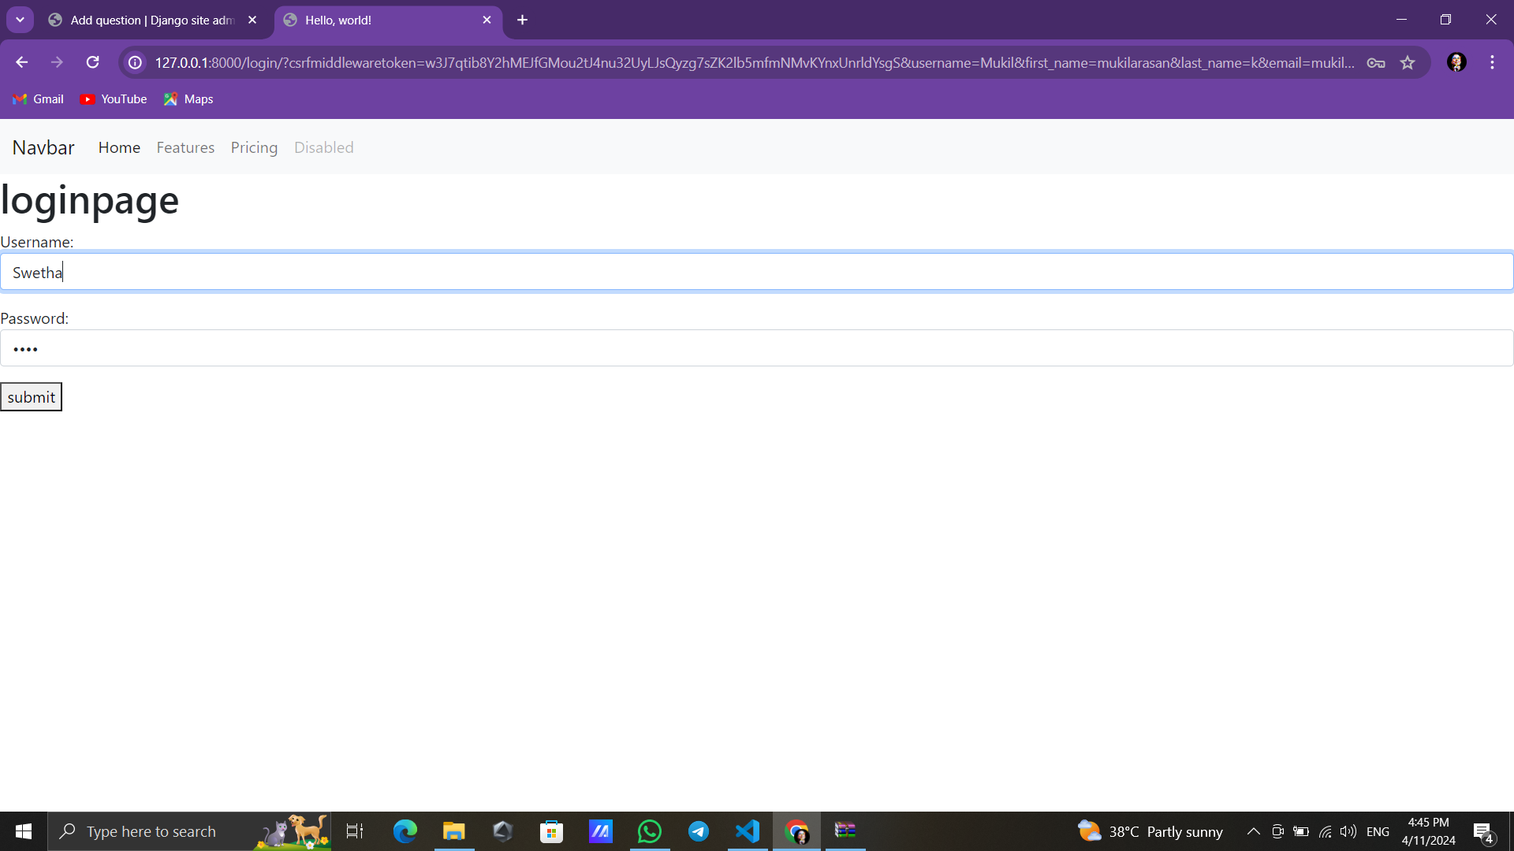
Login page

Slide 13
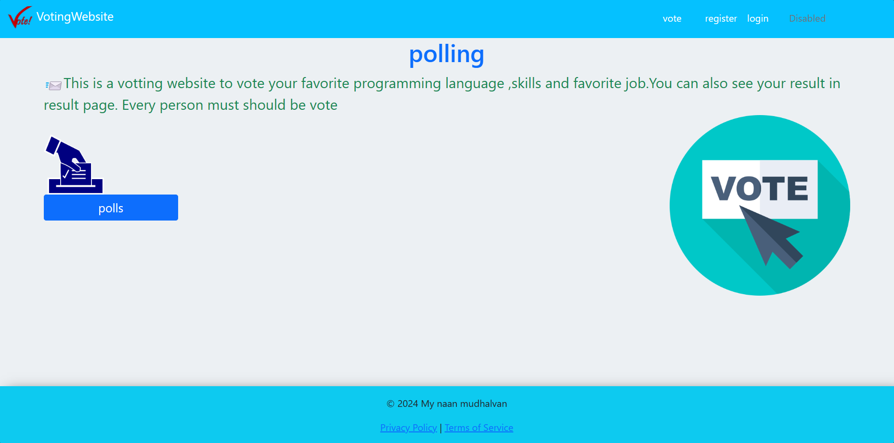
Home-page

Slide 14
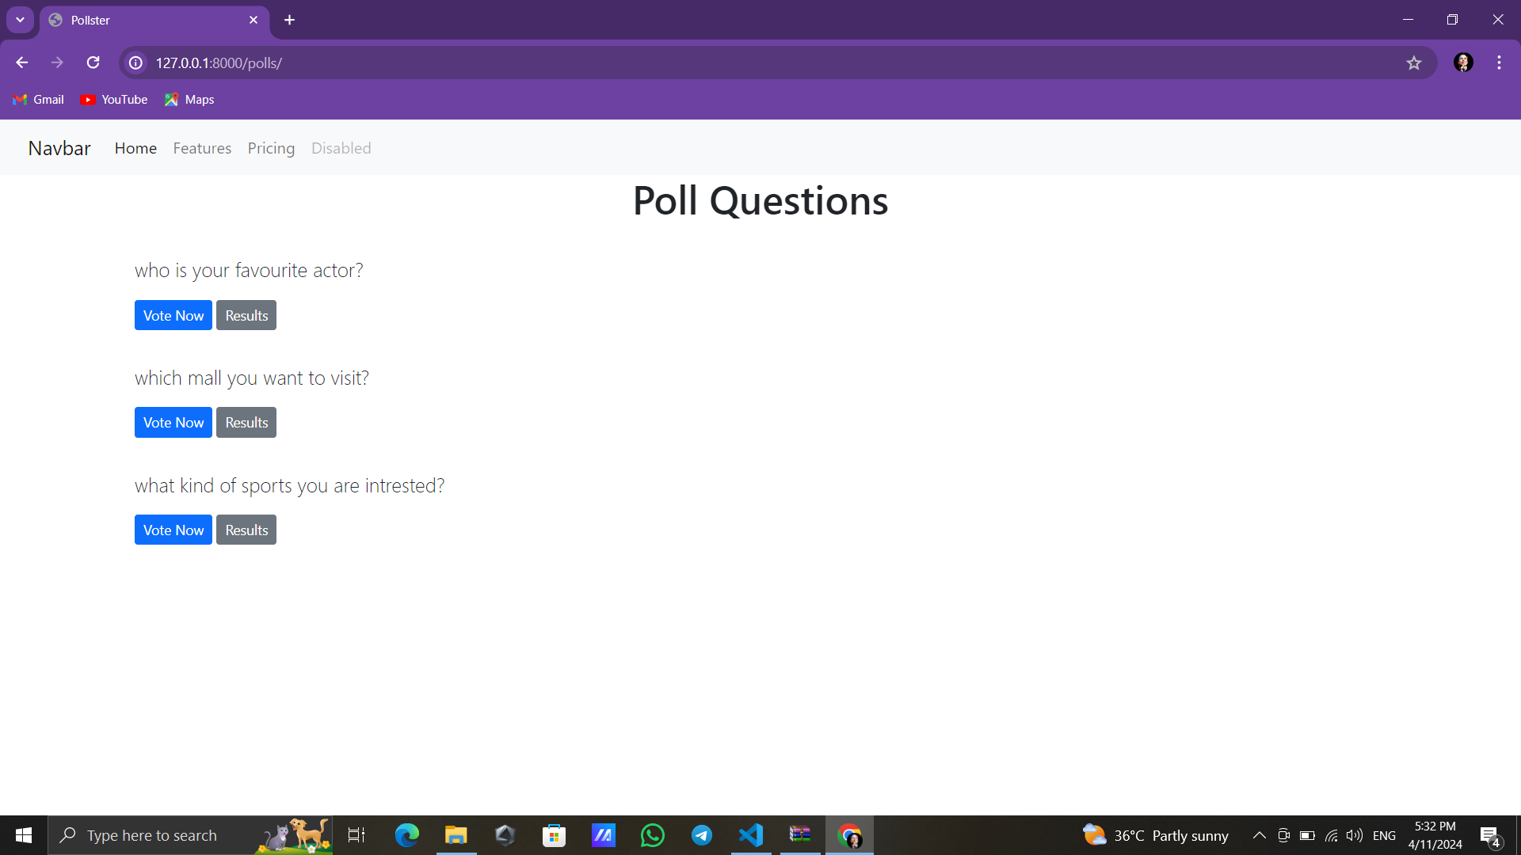
Question-page

Slide 15
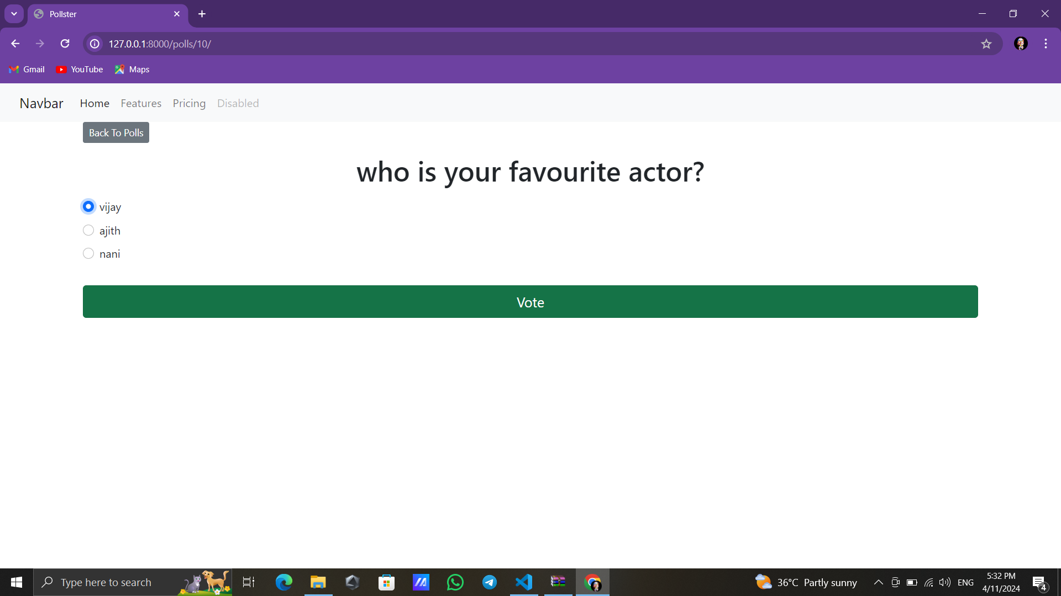
Question-page

Slide 16
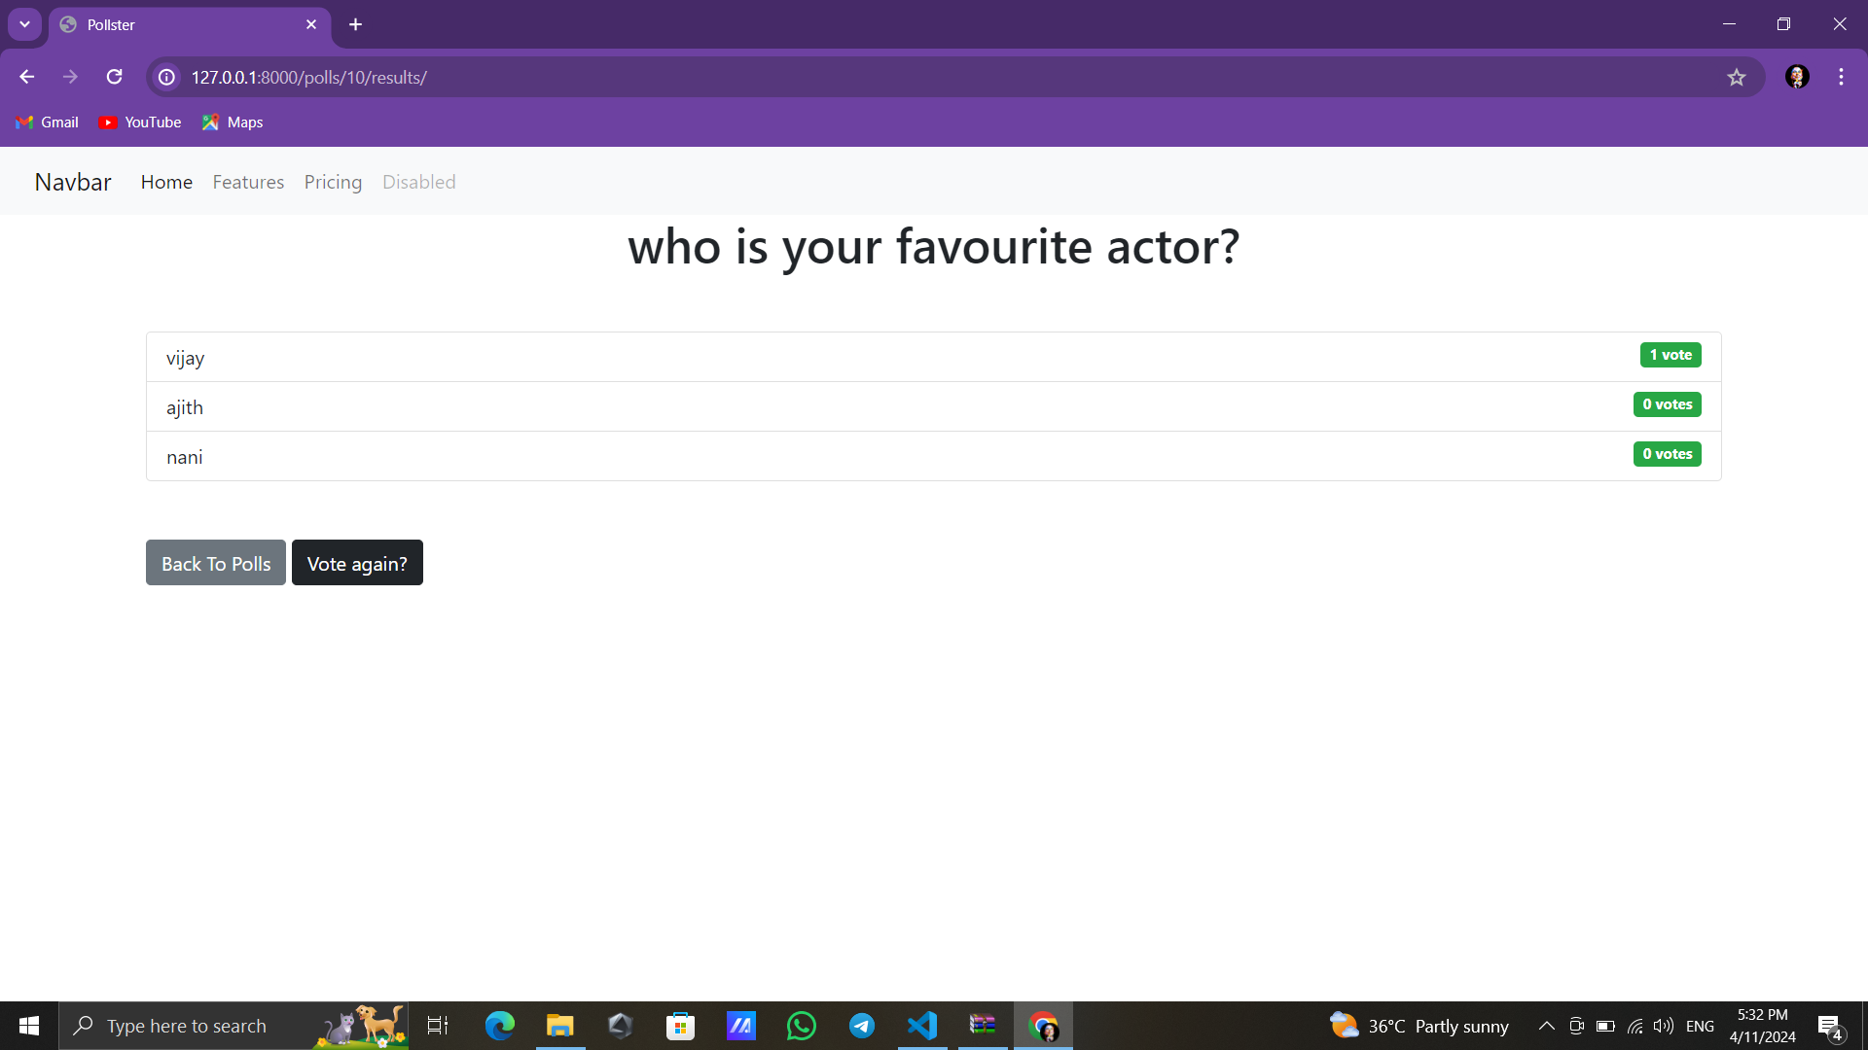

Slide 17
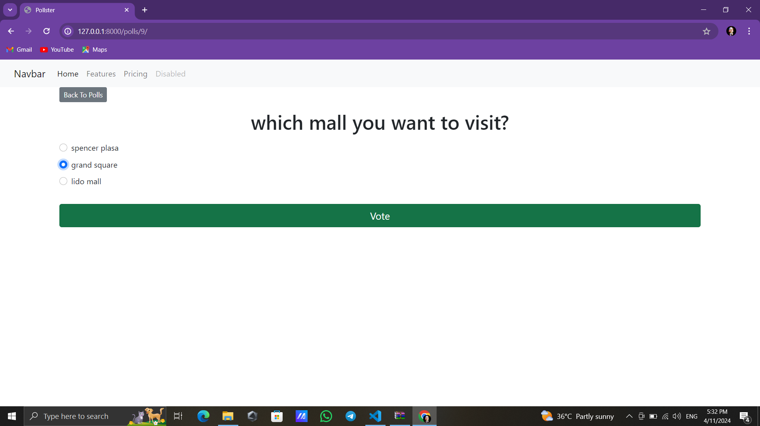
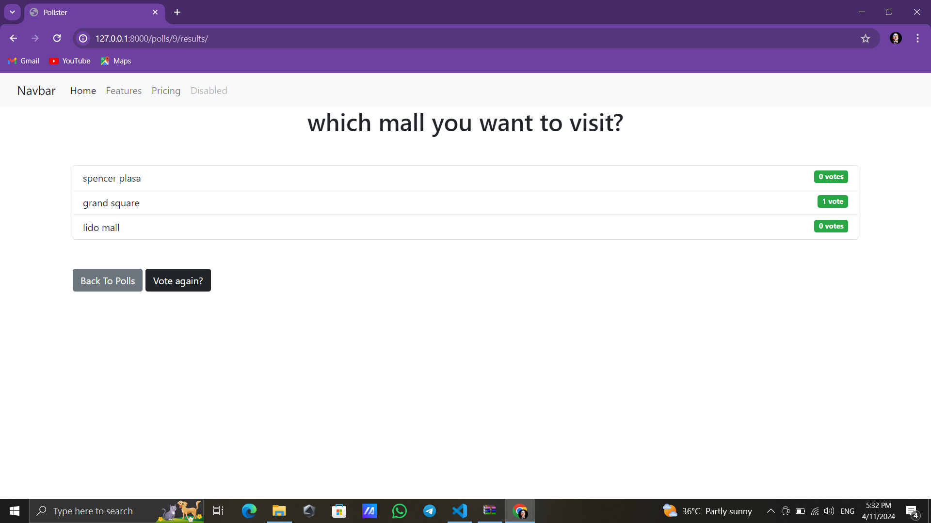

Slide 18
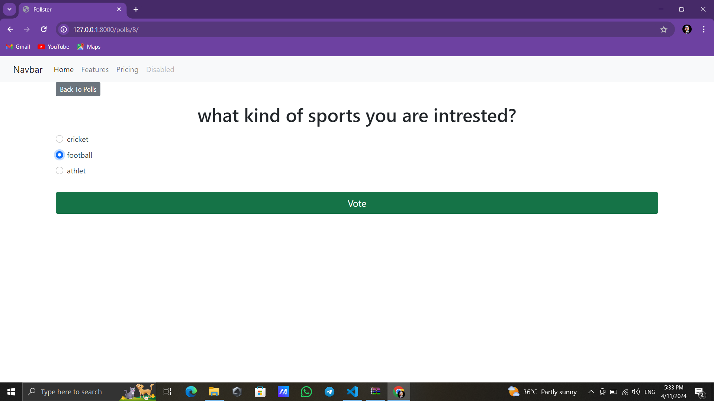

Slide 19
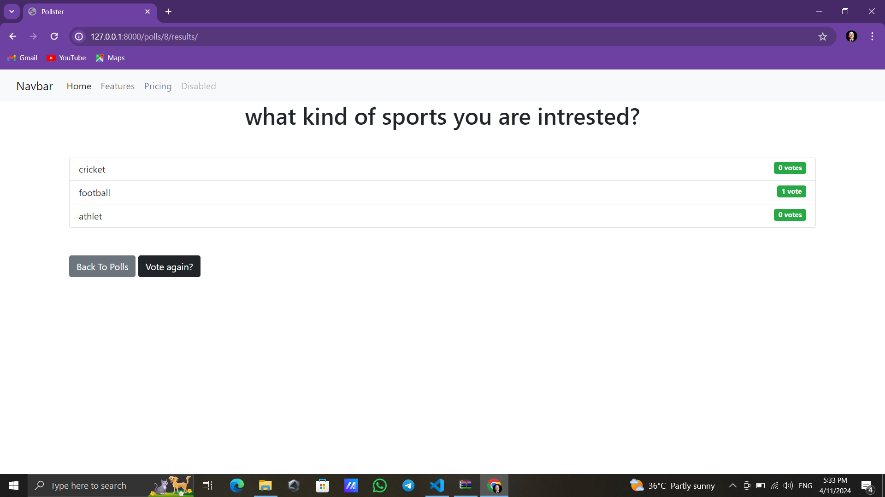
Result-page

Slide 20
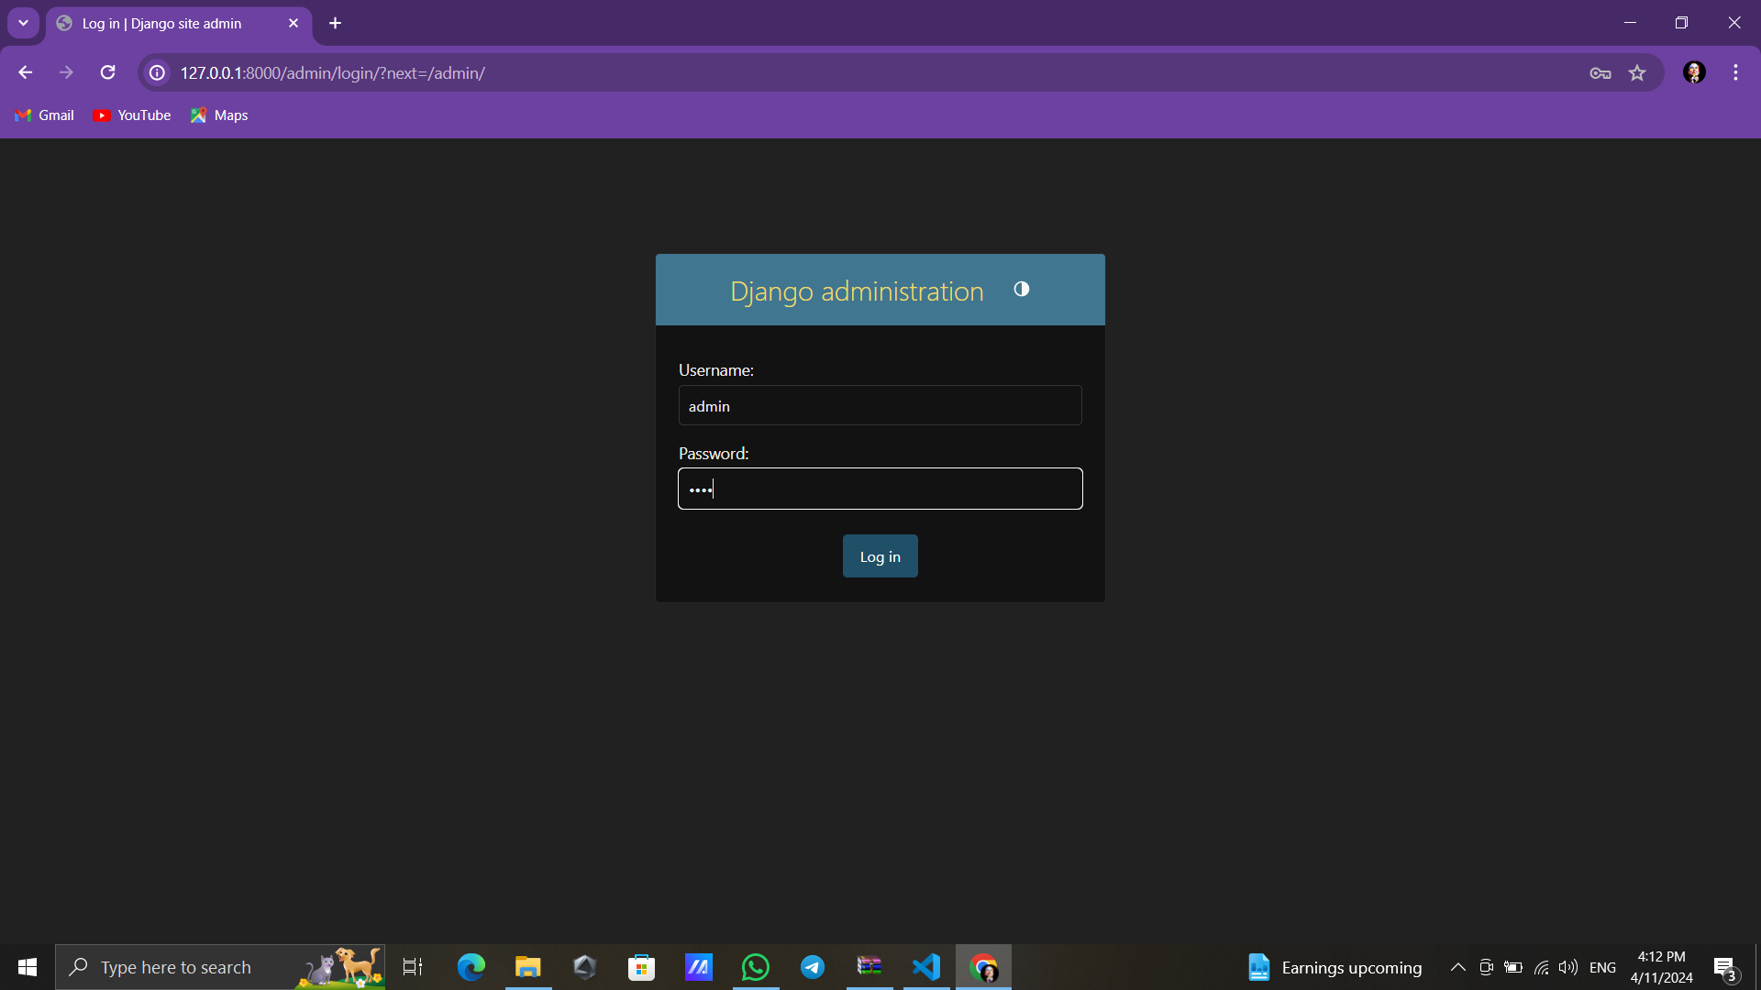

Slide 21
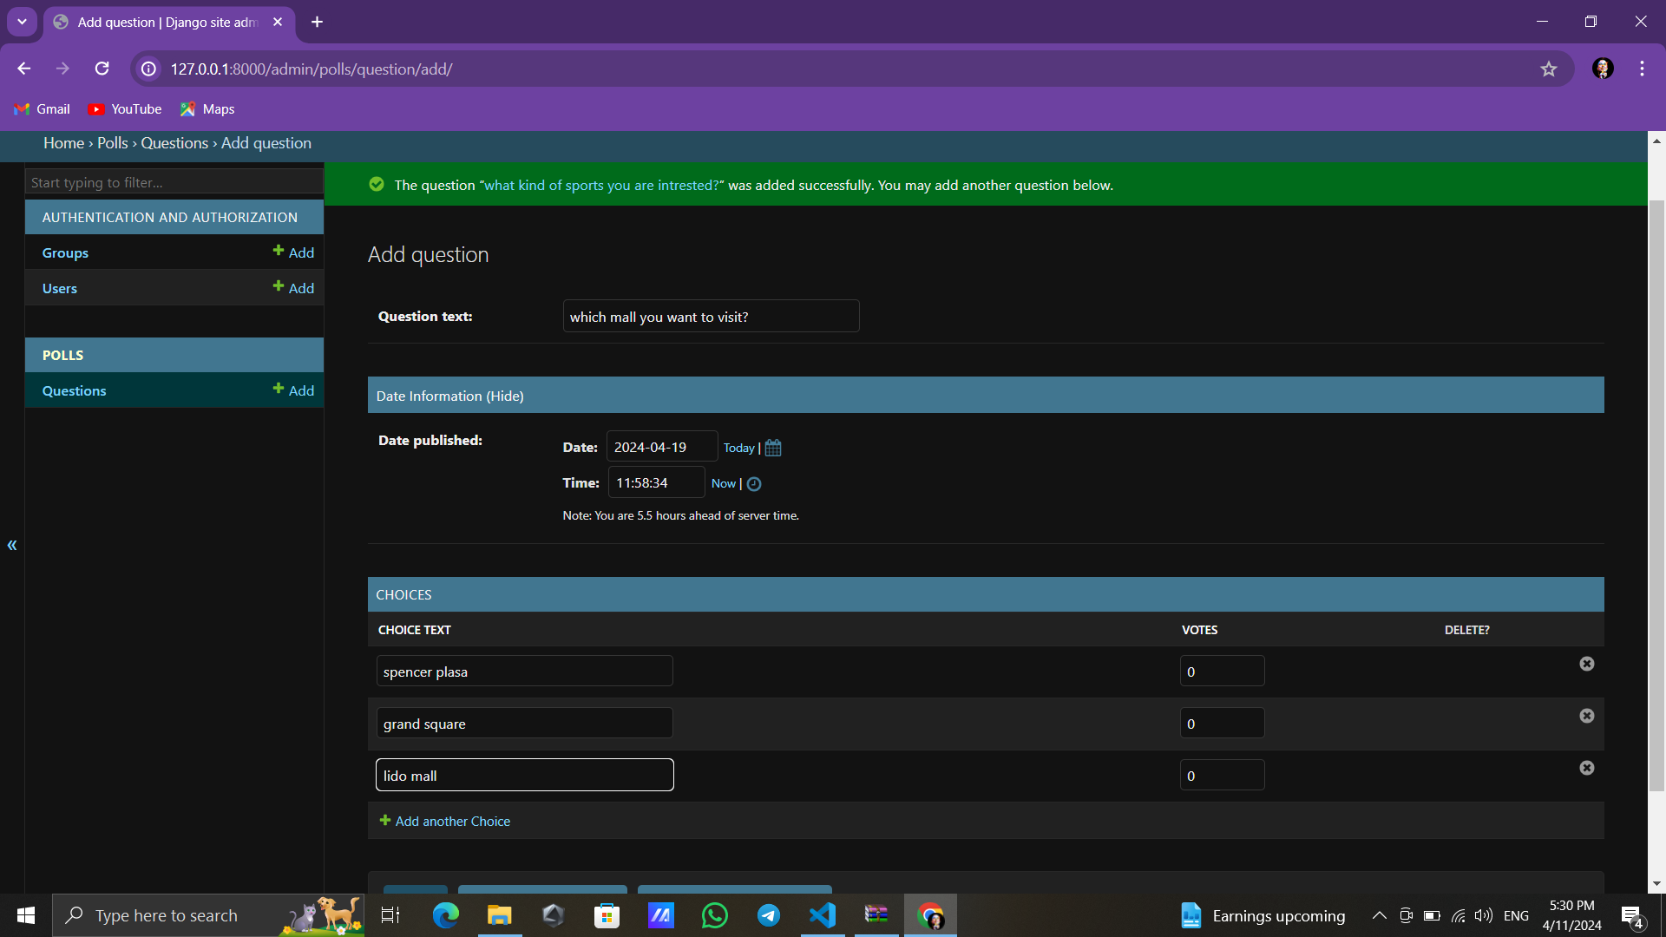

Slide 22
Conclusion
In conclusion, the Django polling application offers a comprehensive solution for conducting polls with various advanced features to enhance user experience and functionality. By leveraging Django's powerful framework, along with modern frontend technologies and third-party services, we've created a robust platform for managing polls and engaging users.
Real-time updates are facilitated through WebSockets or server-sent events, providing users with instant feedback on poll results without requiring page refreshes.
Source :

Slide 23
Thank You!
Notes:
Thank You !!

